Slide 3
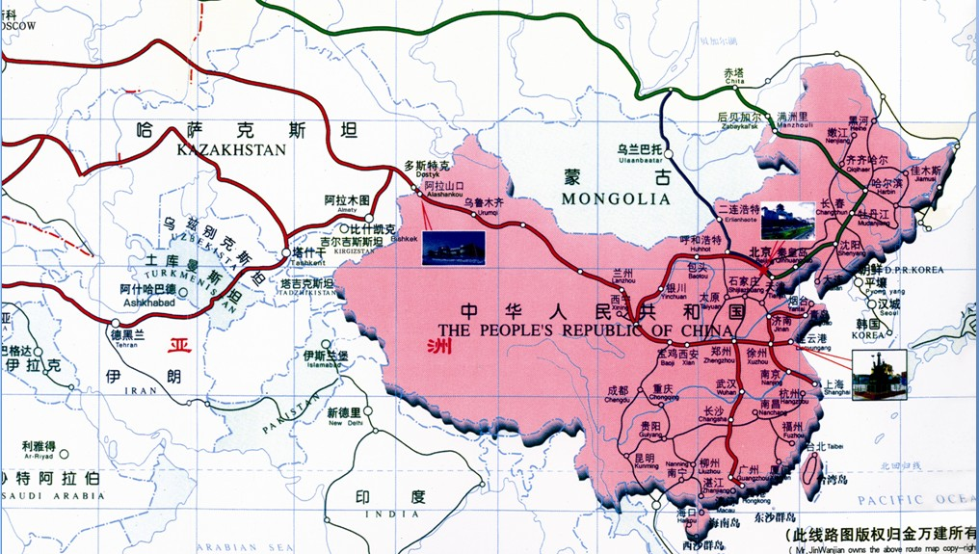

Slide 8
About UCSSIC | | | News Dynamic | | | Related Project | | | Download Center | | | Cooperation Agency | | | Feedback | | | Contact Us

